Slide 1
Genome Sequencing and Annotation
Michael R. McKain
Donald Danforth Plant Science Center
September 27, 2016

Slide 2
Overview
Types of Genomes
Modern Sequencing Platforms
Illumina
Types of Libraries
PacBio
Nanopore
Assembly Workflow
Fast-Plast: Assembling a chloroplast genome
Annotation
Verdant: Annotating a chloroplast genome

Slide 3
Organisms have multiple genomes
Nuclear/Nucleoid
Everything?
Mitochondrial
Eukaryotes, except Monocercomonoides
Chloroplast
Green things, red things, diatoms, and more?
Apicoplast
Vestigial red algae-derived chloroplast in apicoplexans (Plasmodium)
Metagenome

Slide 4
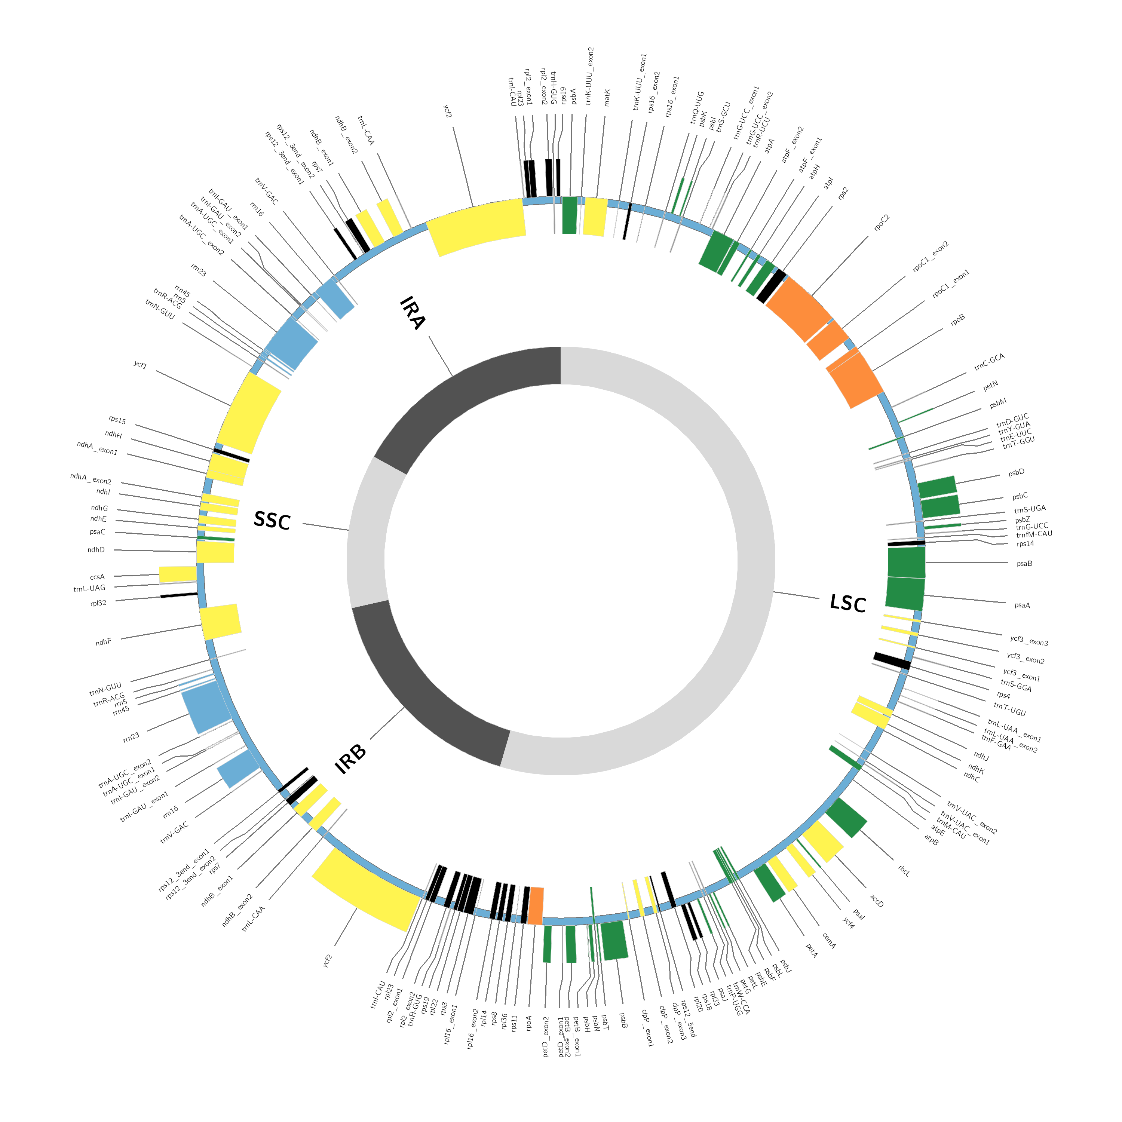
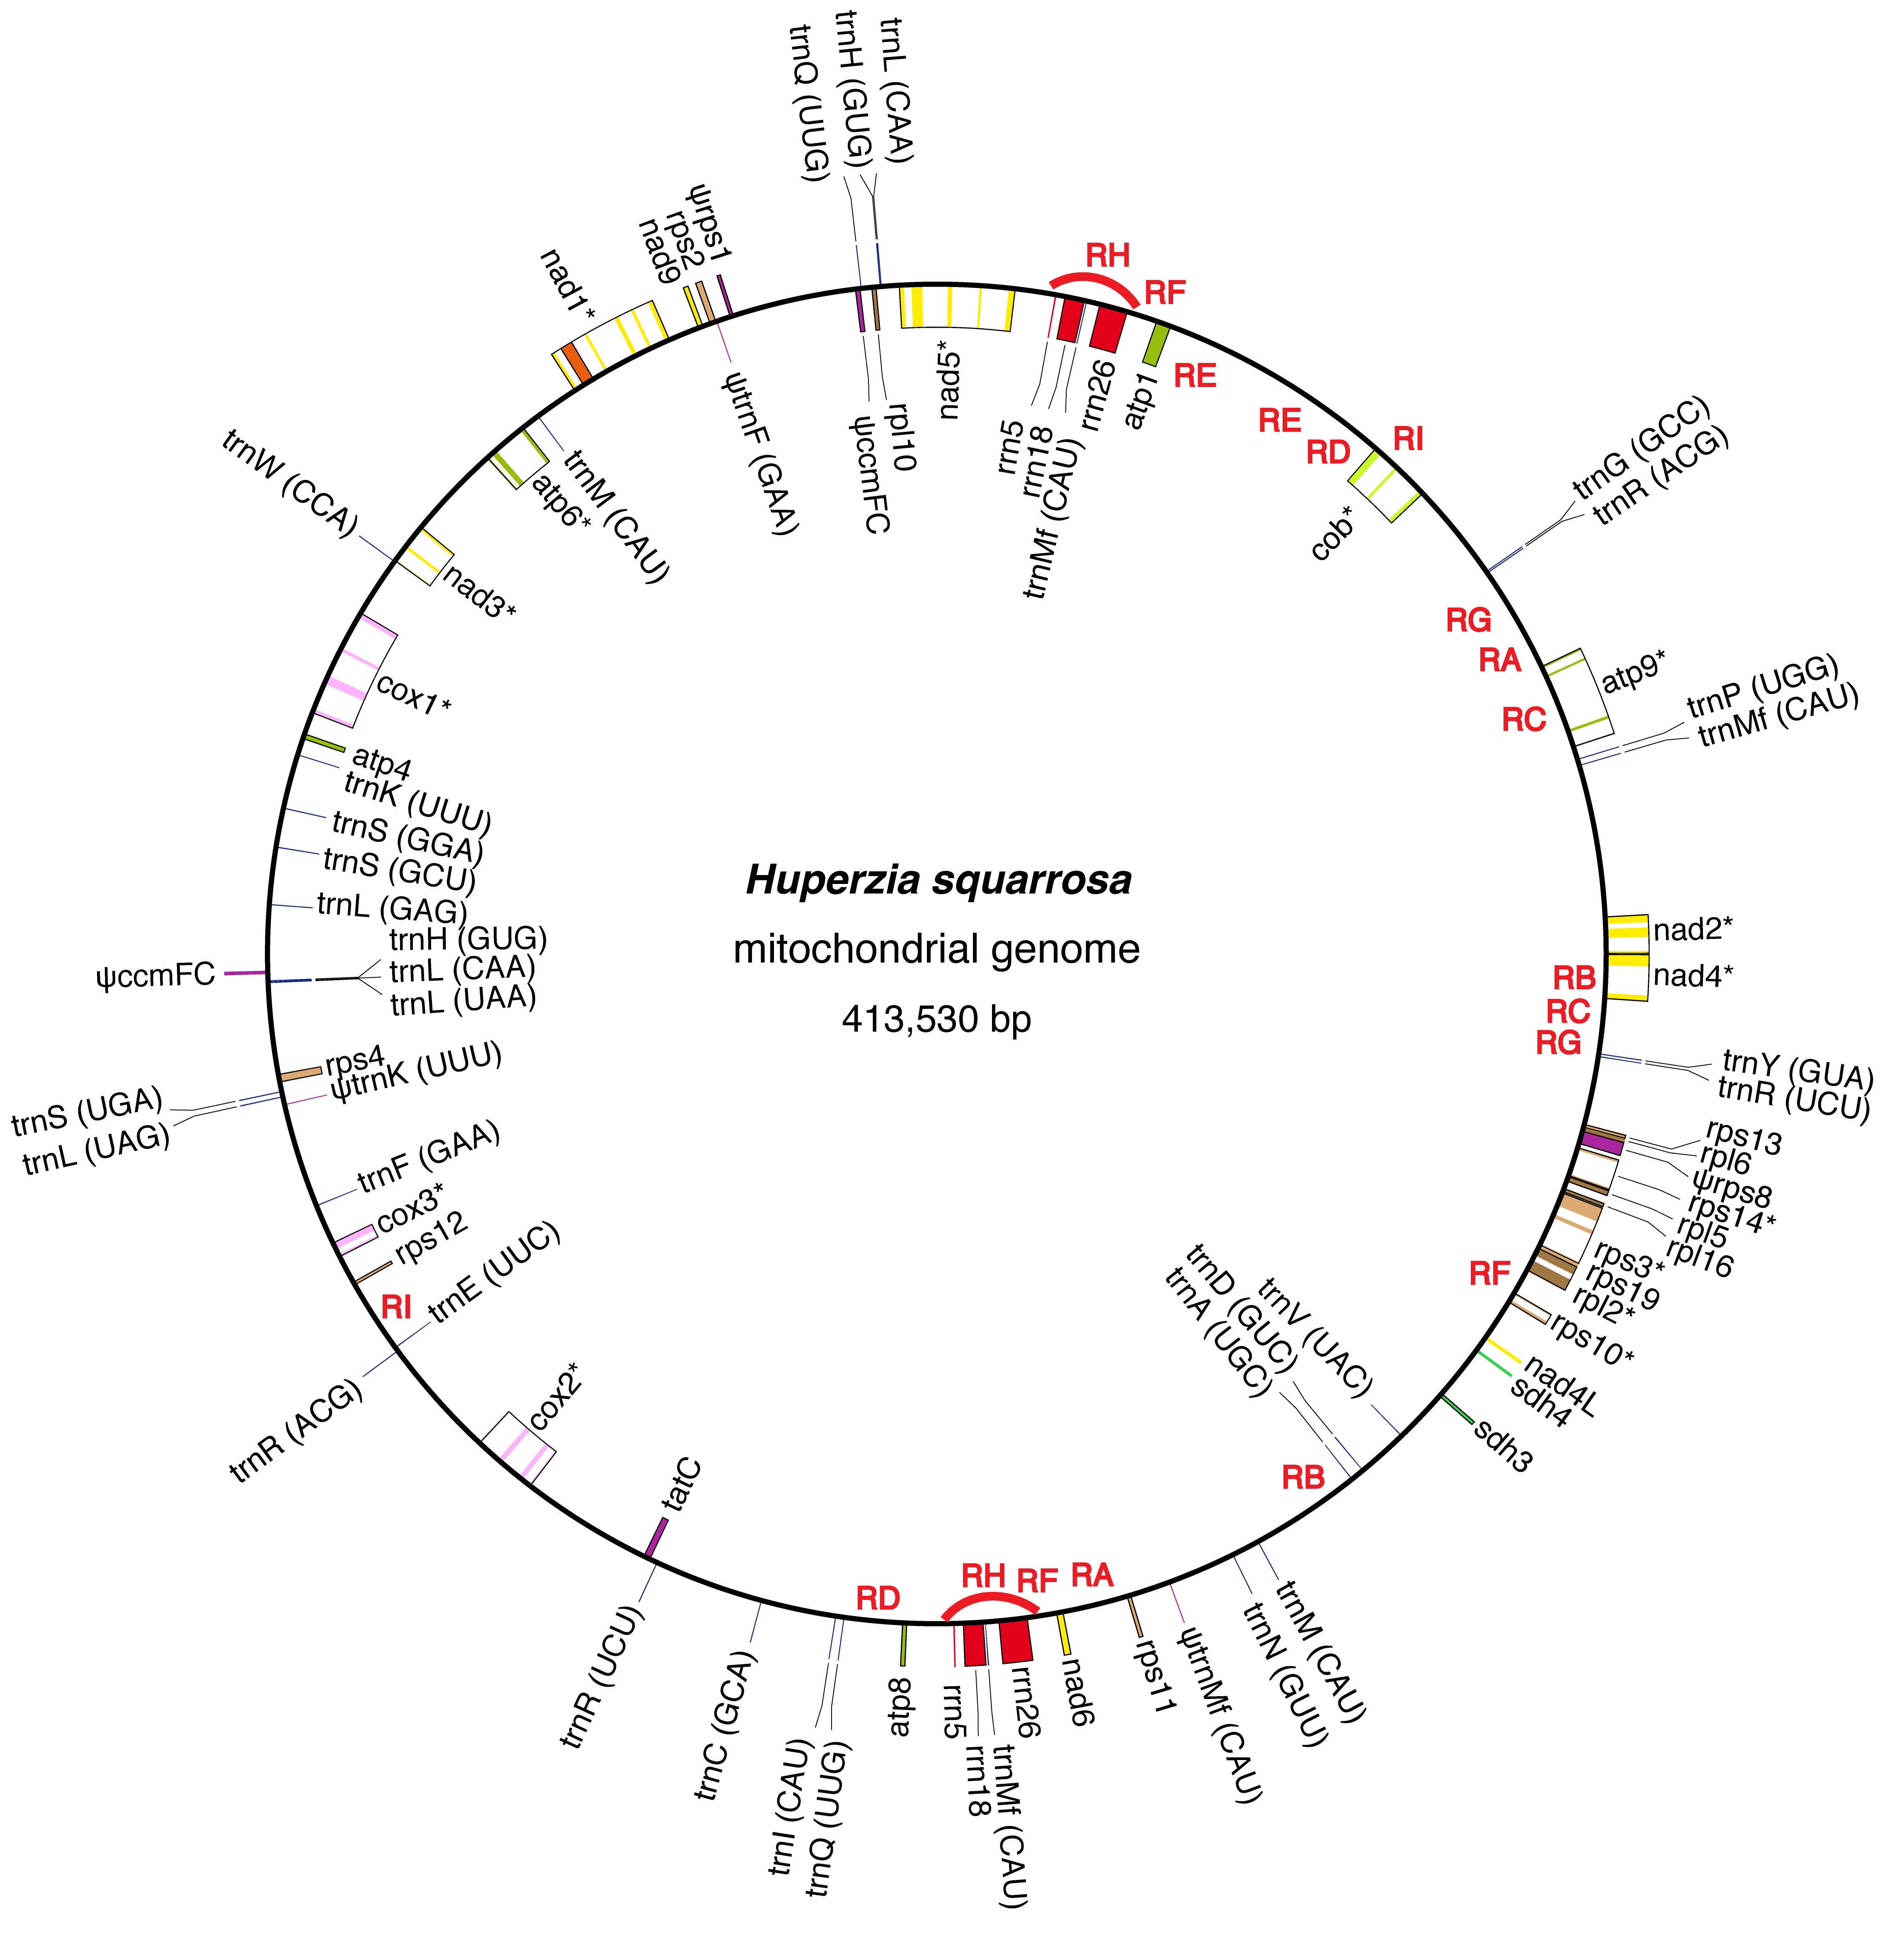
Zigadenus glaberrimus
Zomlefer et al. 2014.
Yucca filamentosa
McKain et al., unpub.
Huperzia squarrosa
Liu et al. 2012

Slide 5
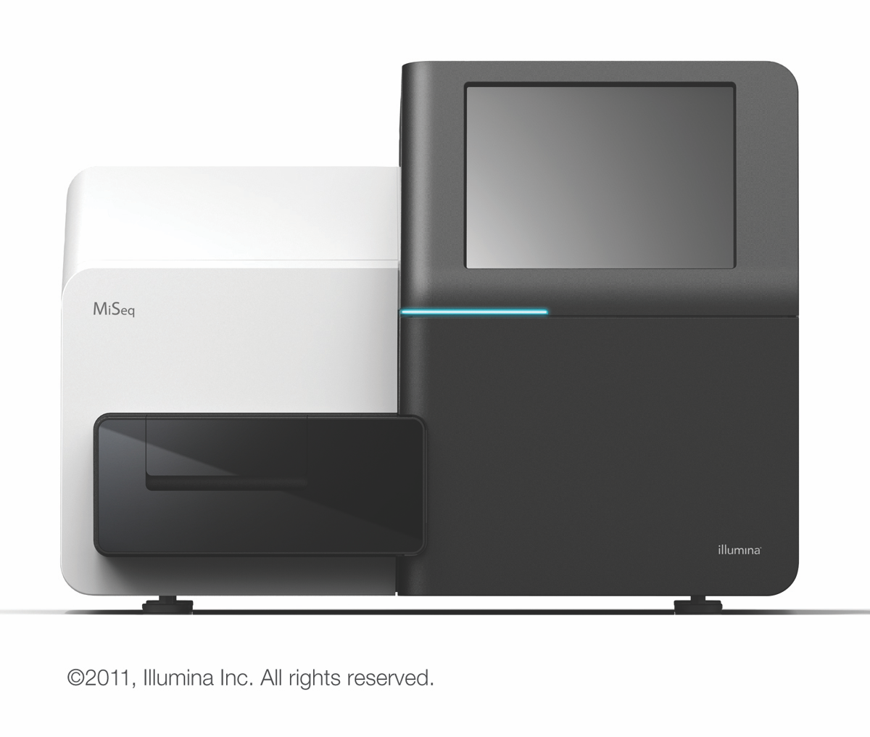
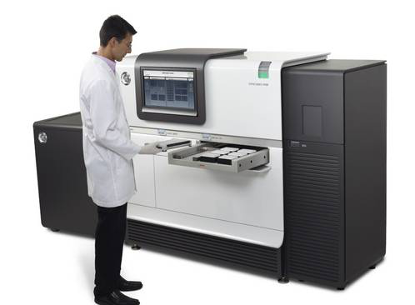
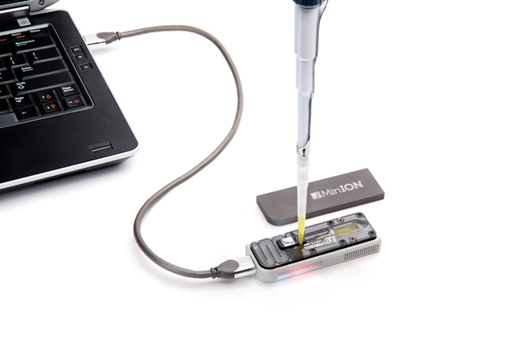
Modern Sequencing Platforms
Illumina
HiSeq2000/2500/4000
NextSeq500
MiniSeq/MiSeq
PacBio
RSII
Sequel*
Nanopore
MinION
PromethION

Slide 6
Illumina VS PacBio VS Nanopore
 | Illumina | PacBio | Nanopore
Read Length | 1x50 -- 2x300 | Average > 10,000 | > 10,000
Longest Read | 300 | >60,000 | >200,000
Number of Reads | 25M -- 5B | 55,000 per SMRT cell | 4.4 - 1250M
Error Rate | 0.10% | 8-12%*; 0.05% corrected | 1% or more
Check Out: http://www.molecularecologist.com/2016/03/2016-ngs-field-guide-preview/

Slide 7
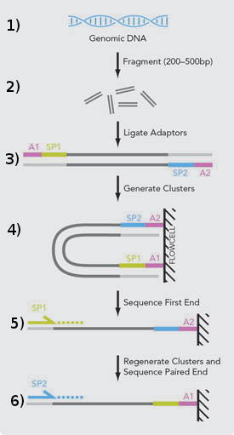
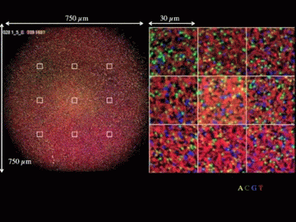
Illumina workflow
Harkess

Slide 8
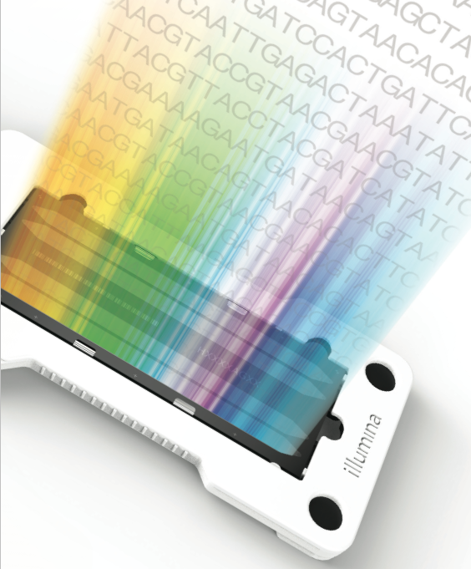
Anatomy of the Illumina flow cell
Flow cell “lane”
clusters
Each cluster generates one or two sequence reads
Miseq = 25 million clusters
NextSeq500 = 400 million clusters
HiSeq2500 = 2 billion clusters
HiSeq4000 = 5 billion clusters
Harkess

Slide 9
Flavors of Illumina sequencing
Genomic DNA extraction
Randomly shear DNA to a short average size (ex: ~600 nt)
Prepare sequencing library
Single end
Paired end
read 1
read 1
200nt – 2000nt long molecules
read 2
Harkess

Slide 10
Mate Pair Long Insert
Sequence read pairs that span a long distance
biotin
5 – 40kb long fragments
biotin
Circularize the molecules
junction
Fragment and enrich
for biotin
Sequence paired end
Now have read pairs that
are actually 5-40kb apart
5 – 40kb long fragments
Harkess

Slide 11
Other Types of Libraries
Hi-C
Uses 3D structure of chromatin naturally occurring in genome
Chicago Method
Dovetail
Hi-C but the DNA is stripped and then “chromatinized”
10X Genomics
Microfluidics that get a single DNA molecule on bead
Molecules have unique barcodes and are sequenced

Slide 12
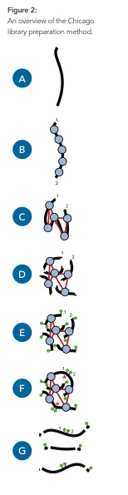
Dovetail Method
HMW DNA stripped of proteins
In vitro chromatin assembly
Crosslinking of histones
Restriction endonuclease digestion of DNA
Blunt the sticky ends with biotinylated nucleotides
Ligation of fragments
Chromatin and biotin not internal to fragments removed
Dovetail White Paper

Slide 13
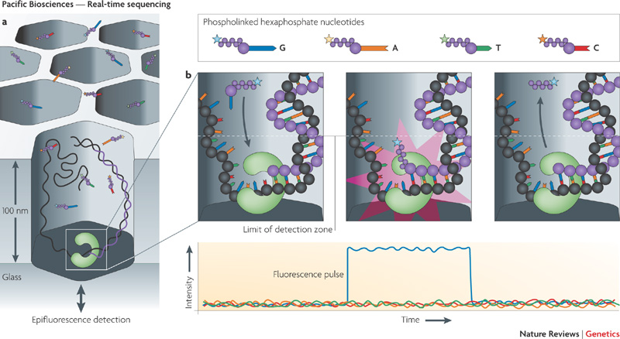
Pacific Biosciences
Real Time, Single Molecule Sequencing
Metzker, 2010

Slide 14
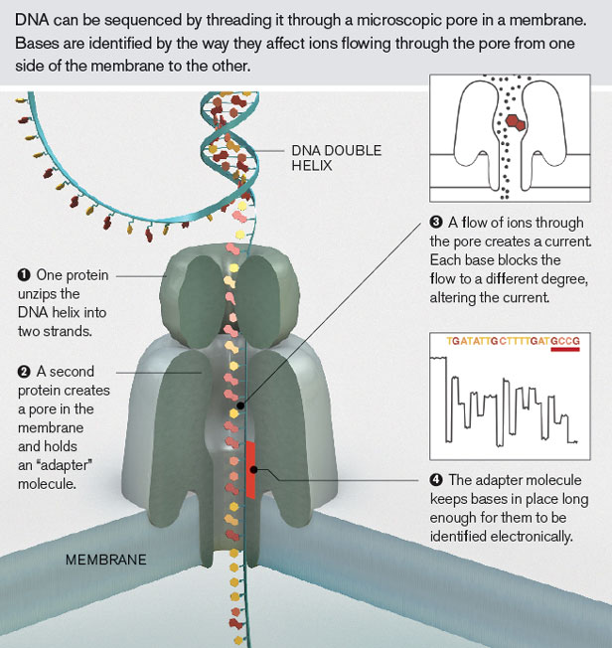
Oxford Nanopore
Single Molecule Sequencing
Detect modifications to DNA
Extremely long reads, possible
Data in a little as 2 minutes
Real time sequencing
http://www2.technologyreview.com/news/427677/nanopore-sequencing/

Slide 15
More to See
http://www.slideshare.net/suryasaha/sequencing-2016
http://core-genomics.blogspot.com/
https://www.reddit.com/r/bioinformatics/
Lot of other resources

Slide 16
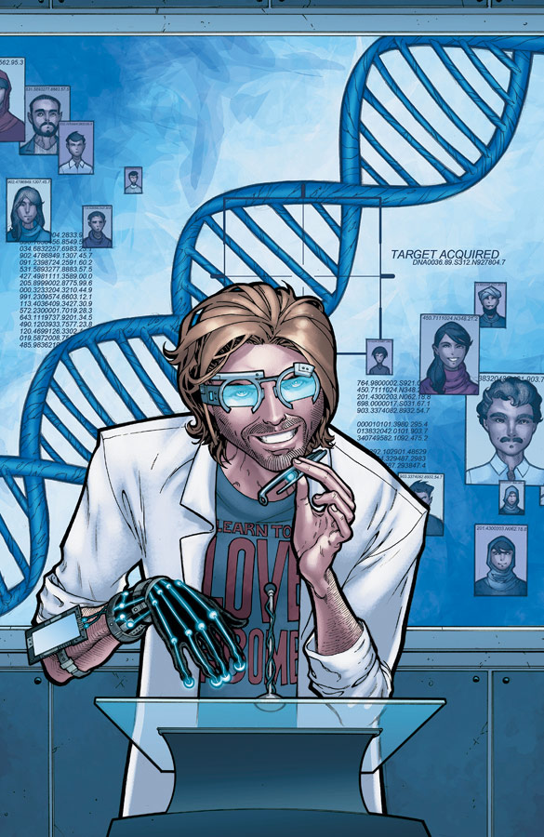
Thinks to think
What platform is best for my project?
Coverage vs. Read Length
Sample number
Cost
What is THE QUESTION?
Sequencing works for you, don’t work for your sequencing
Think Tank, July 2013 Image Comics

Slide 17
Basic Steps to Any–ome Assembly
Clean your data
Reduce your data
Assemble
QC Assembly
Validate Assembly
Repeat Steps 3-5.

Slide 18
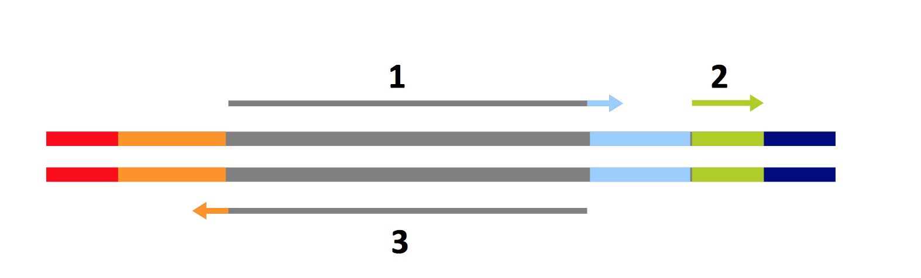
Fast-Plast: Clean the Data
Use Trimmomatic to remove adapter sequences and low quality bases
DNA insert
Adapter
If a read is longer than the DNA insert, it will sequence into the adapter.
Available at: https://github.com/mrmckain/Fast-Plast
Other options: FastX, Cutadapt

Slide 19
Poor Quality?
Reads usually come in FASTQ format
ID
@D00653:206:C9C6VANXX:1:1102:19019:2314 1:N:0:CGCTCATT+TAATCTTA
GTAACCTAATAAAATAAAAACCAAGCAAATGCTCTTTTTCCTAAATTAAAATATGGGATCCTTTTTATTTAAGATCCTCTTTTCTCCATCTCATTTCTACTTCTACTGCTTATTGGGATGTCTATGTGACCCATAGAAAGTTGGTCATATAATACATACA
+
B<BBBBFFFFFFFFFFFFFFFFFFFFFFFFFFFFFFFFFFFFFFFBFFFFFFFFFFFFFFFFFFFFFFFFFFFFFBFFBFFFFFFFFFFFFFFFFFFFFFFFFFFFFFFFFFFFFFFFF<BFFBF/FFFFFFFFBB<FFFFFFFFFFFFFFFFBBFFFFF
Sequence
The + Line
Quality
Quality score line is converted from ASCII characters to a number
Currently: Phred 33 is used
Scoring starts at the 33rd ASCII character (!) and ends at the 41st (I == capital i).

Slide 20
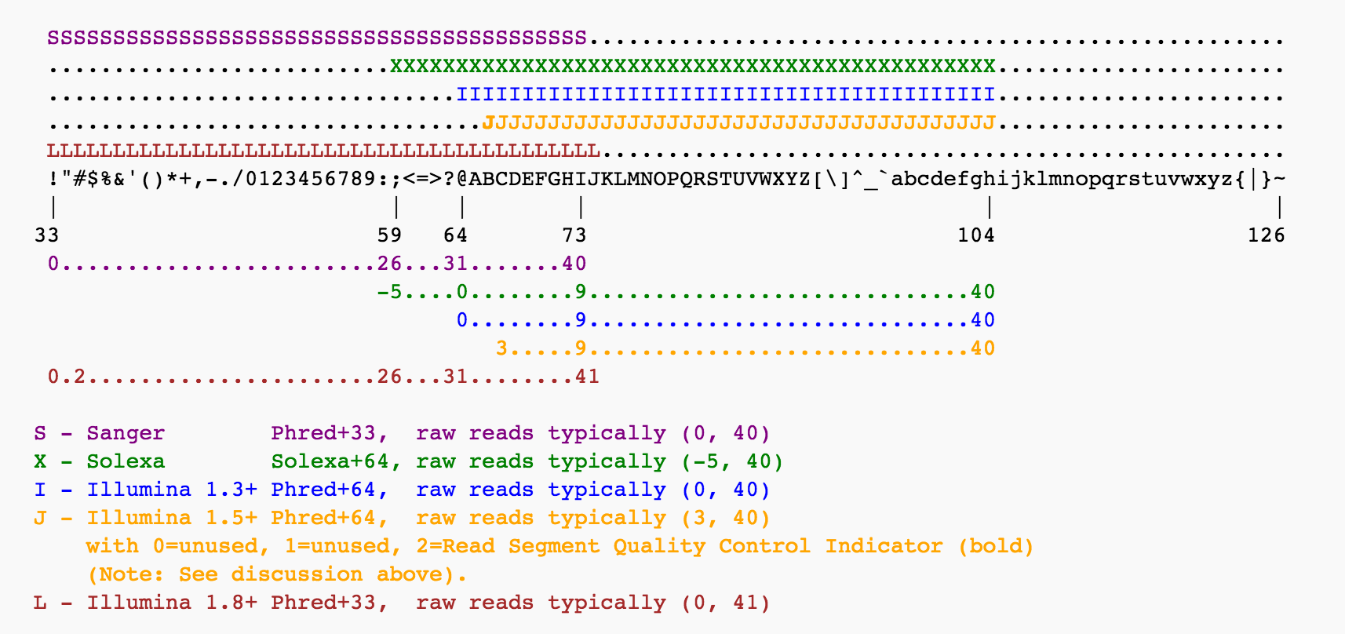
Phred Scoring Systems
Wikipedia

Slide 21
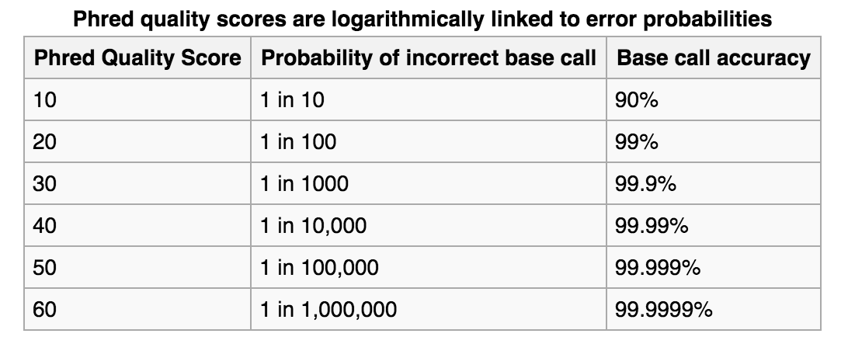
What does it mean?
Programs for read cleaning allow you to choose the threshold for Phred scores
Wikipedia

Slide 22
Fast-Plast: Clean the Data
Trimmomatic Settings: --phred33
--ILLUMINACLIP:NEB-PE.fa:1:30:10
adapters:seedMismatch:palindromeClip:simpleClip
--SLIDINGWINDOW:10:20
windowLength:phredThreshold
--MINLEN:40
ORDER MATTERS!
Trimmomatic Available: http://www.usadellab.org/cms/?page=trimmomatic

Slide 23
Fast-Plast: Reduce the Data
Many of our data sets are low coverage whole DNA sequencing
AKA shotgun, GSS, some others
Chloroplast genomes constitute ~1-5% of total DNA in photosynthesizing angiosperms
Computation is costly
Storage is costly
Chloroplast
Nuclear, mitochondrial, and other
Check out: Muir et al. 2016

Slide 24
Fast-Plast: Reduce the Data
Map reads using Bowtie2
Fast-Plast has a bowtie2 index for 300+ angiosperm chloroplast genomes
Trimmed reads are aligned to these plastomes to find “chloroplast-like” reads
Reduces the dataset from millions to thousands of reads
Bowtie2 Parameters: --very-sensitive-local
Bowtie2 Available: http://bowtie-bio.sourceforge.net/bowtie2/index.shtml

Slide 25
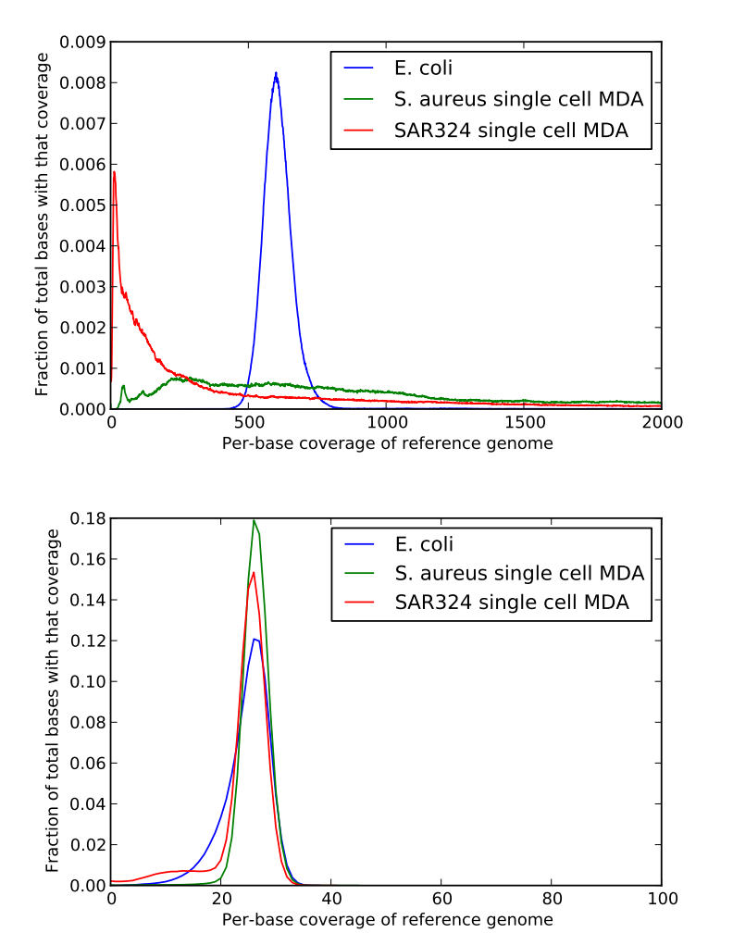
Fast-Plast: Reduce the Data
The Hyb-Seq Issue
Sequence capture data has highly variable coverage
Problem for most assembly programs
Solution:
Read normalization
Brown et al. 2012
Check out: http://ivory.idyll.org/blog/trinity-in-silico-normalize.html

Slide 26
Fast-Plast: Assemble
There are a lot of assemblers out there
Assemblers all have quirks
Try multiple assemblers (this is really step 7)
Use the biology to pick the assembler that best works for your system
Or design the project from the beginning (e.g. ALLPATHS-LG)

Slide 27
Fast-Plast: Assemble
Initial assembly in SPAdes
Uses de Brujin Graphs
Why SPAdes?
Originally for single cell/microbial genomes
SPAdes Avaliable: http://bioinf.spbau.ru/spades
Martin and Wang, 2011

Slide 28
Fast-Plast: Assemble
Initial assembly in SPAdes
SPAdes Parameters:
Use the mapped reads only, --only-assembler option, set of 3 kmers that fit YOUR data*
*If the kmers go outside of your read length, SPAdes will ignore chosen kmers of that size.

Slide 29
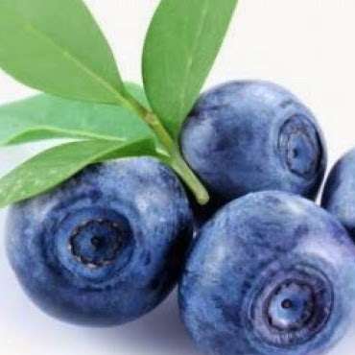
Fast-Plast: Assemble
SPAdes uses a coverage model for assembly
This does not work for chloroplast genomes due to the inverted repeat
Often there are multiple contigs for chloroplast genome, which is annoying for high throughput performance
“Seed-based microassembly”
Essentially, in silico chromosome walking
afin
Afin Available: https://github.com/mrmckain/Fast-Plast

Slide 30
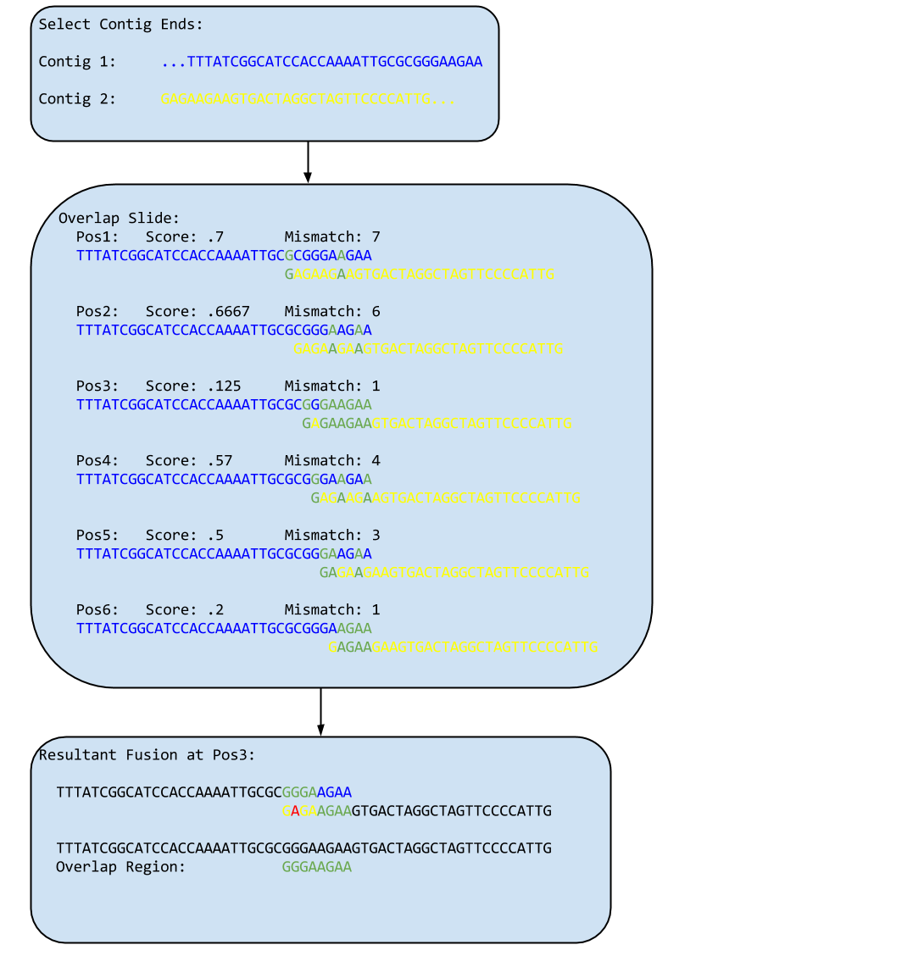
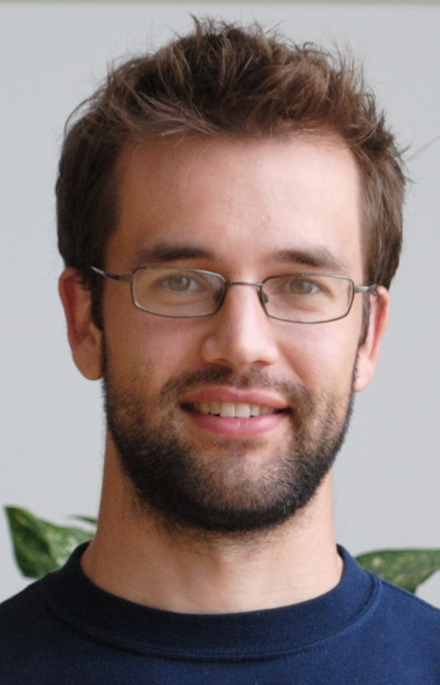
Fast-Plast: Assemble
afin: Fusion
Mark Wilson

Slide 31
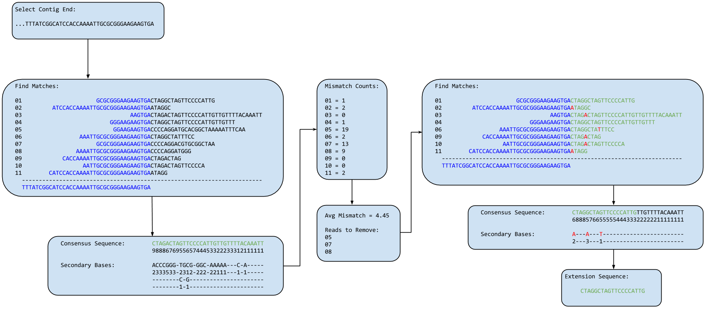
Fast-Plast: Assemble
afin: Extension
Mark Wilson

Slide 32
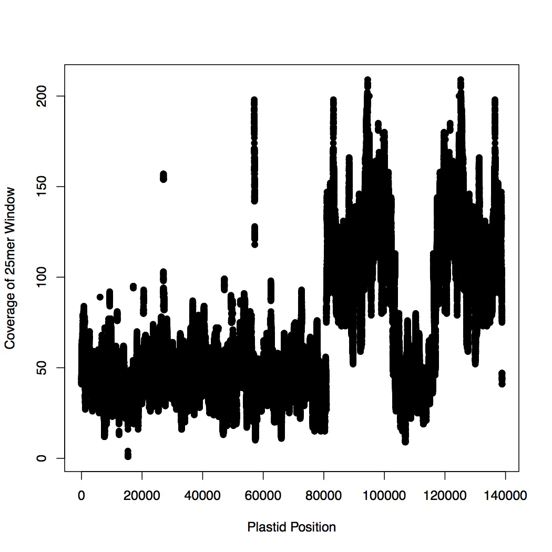
Fast-Plast: Validate/QC
Full automated assembly
Hyparrhenia dichroa

Slide 33

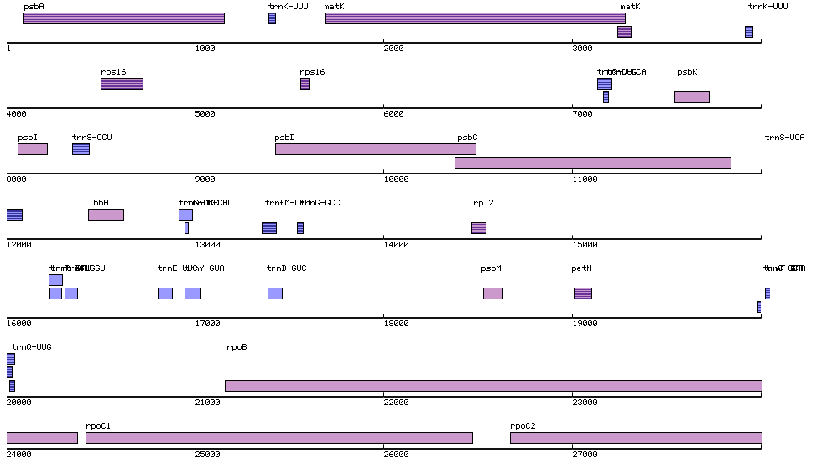
Verdant: Annotation
Most often done in DOGMA
Semi-automated, still requires manual checking

Slide 34


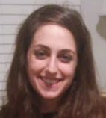
Automating the Annotation Process
Ryan Hartsock
Molly Wohl
http://verdant.iplantcollaborative.org/

Slide 35

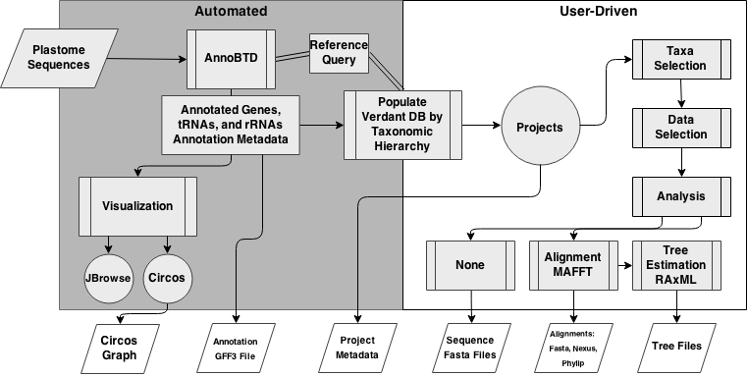
Workflow

